Slide 1
Lecture 29:
IR spectroscopy

Slide 2
Exam III covers material from lectures 20 - 28
(starting at reactions of secondary alkyl halides and ending with amine lecture)
All Buddy Questions with and without answers and old exams will be on Blackboard

Slide 3
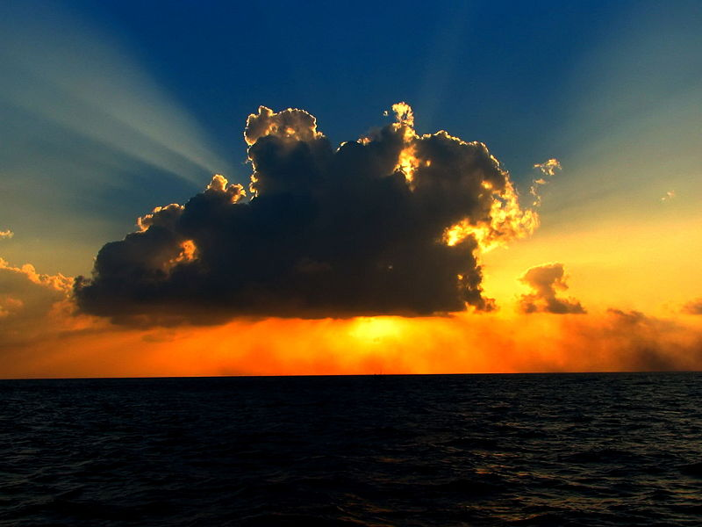

Slide 4
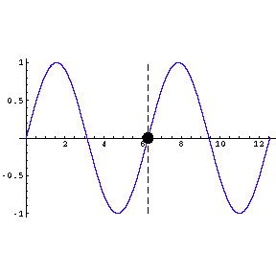
The Wave Nature of Light
Light is a form of electromagnetic radiation.
wavelength
λ
amplitude
A
c ( m s⁻¹ )
Frequency
ν ( s⁻¹ ) =
Shorter wavelength =
higher frequency
λ ( m )
c = 3.0 x 10⁸ m s⁻¹

Slide 5
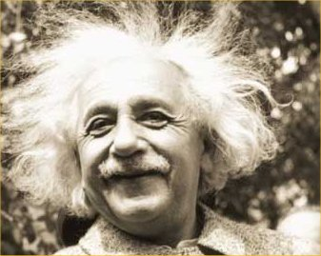
The Particle Nature of Light
Einstein
Light energy is quantized and depends on its frequency
Photon is the elementary particle of light
Energy of a photon E = h ν

Slide 6
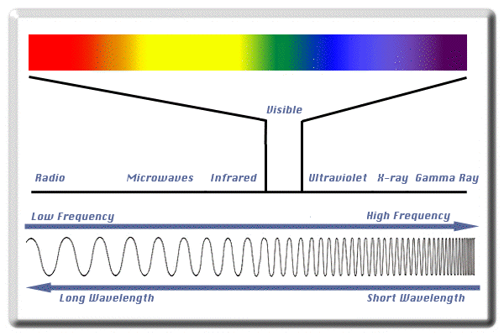
Electromagnetic Spectrum
Frequency (ν) and wavelength (λ) are inversely proportional
c = λν, where c is the speed of light
Energy per photon (E) = hν, where h is Planck’s constant

Slide 7
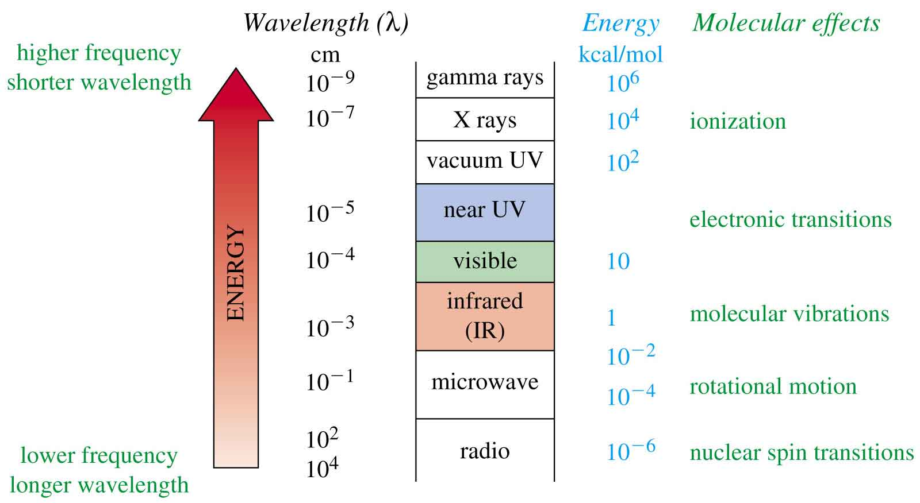
The Spectrum and Molecular Effects
=>

Slide 8
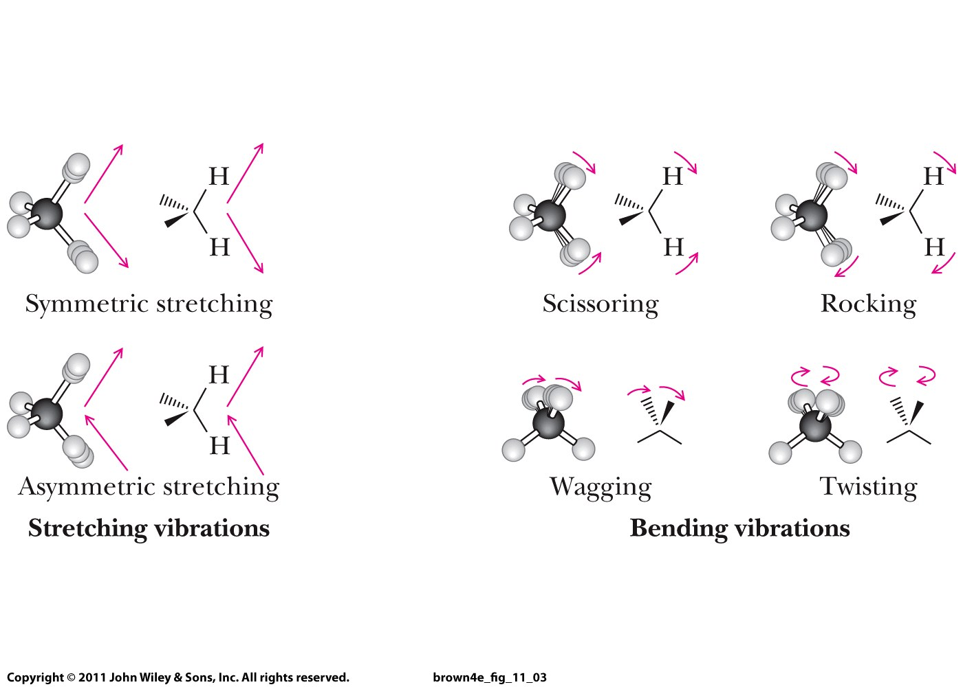
Vibrating polar bonds can absorb IR energy to move to a higher vibrational energy level.
Fundamental modes of vibration of a methylene (CH₂) group:

Slide 9
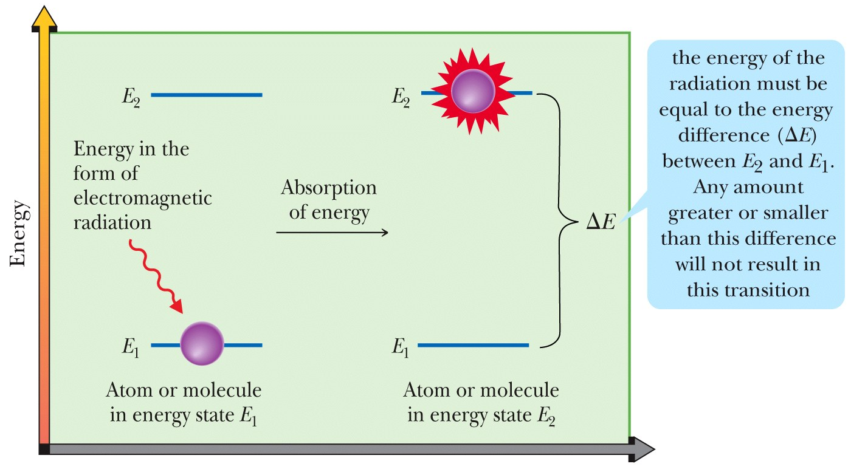
For a bond to absorb IR radiation
  The frequency of radiation must match the frequency of a bond vibration.
  The bond undergoing vibration must be polar.
  The greater the polarity, the stronger the absorption.

Slide 10
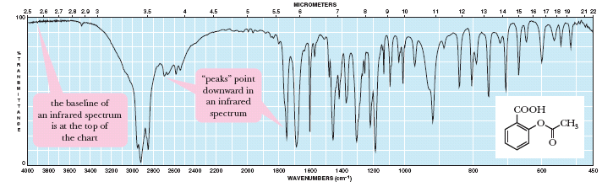
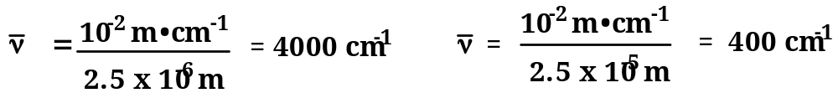
Infrared Spectroscopy
Aspirin
λ
  Wavenumber (ν): The number of waves per centimeter, cm⁻¹
cm / λ

Slide 11
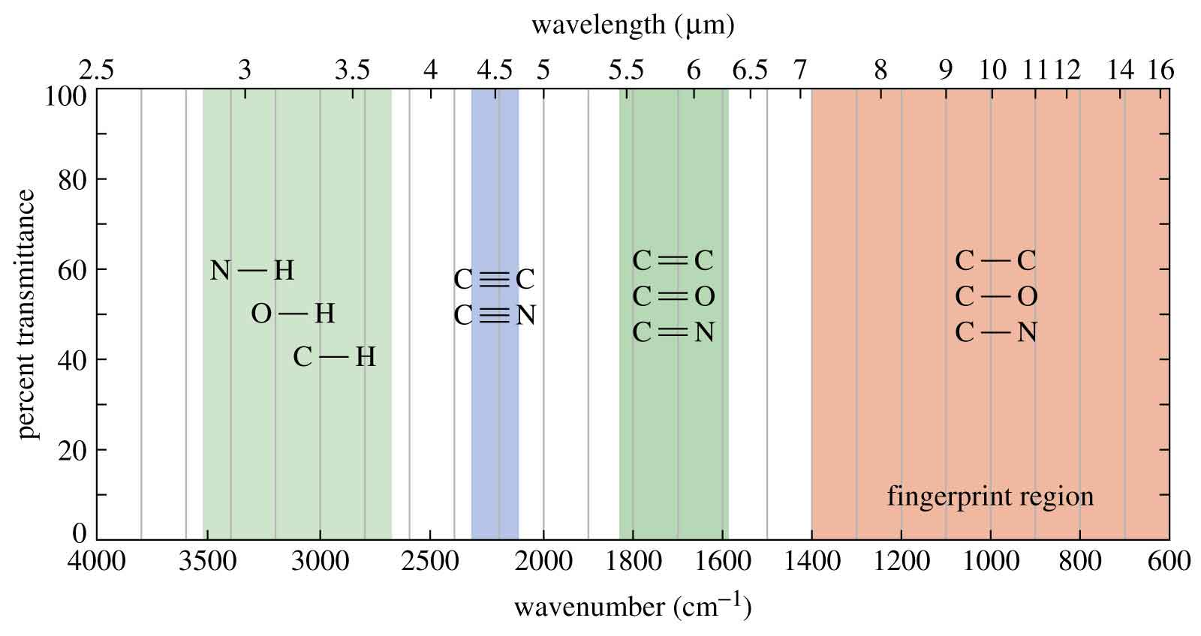
Summary of IR Absorptions

Slide 12
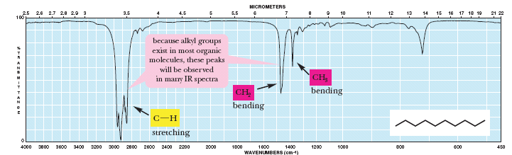
Alkanes

Slide 13
Summary of IR absorptions:
Alkanes: 2800 – 3000 cm⁻¹, 1400-1500 cm⁻¹
C=C: 3100 cm⁻¹, 1600 cm⁻¹
ROH: broad OH, 1050 – 1250 cm⁻¹
ROR: 1050 – 2050 cm⁻¹
Amines: 3100-3500 cm⁻¹ : 1º: 2 peaks, 2º: 1 peak, 3º: no peaks
C=O: 1705 – 1780 cm⁻¹
Benzene: 3030 cm⁻¹, 1700 – 2000 cm⁻¹ (benzene fingers), 1600 cm⁻¹, 1500 cm⁻¹, 700 – 750 cm⁻¹

Slide 14
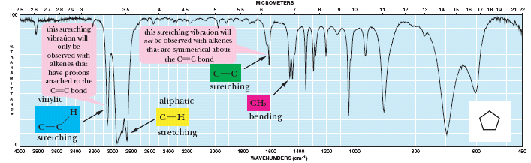
Alkenes

Slide 15
Summary of IR absorptions:
Alkanes: 2800 – 3000 cm⁻¹, 1400-1500 cm⁻¹
C=C: 3100 cm⁻¹, 1600 cm⁻¹
ROH: broad OH, 1050 – 1250 cm⁻¹
ROR: 1050 – 2050 cm⁻¹
Amines: 3100-3500 cm⁻¹ : 1º: 2 peaks, 2º: 1 peak, 3º: no peaks
C=O: 1705 – 1780 cm⁻¹
Benzene: 3030 cm⁻¹, 1700 – 2000 cm⁻¹ (benzene fingers), 1600 cm⁻¹, 1500 cm⁻¹, 700 – 750 cm⁻¹

Slide 16
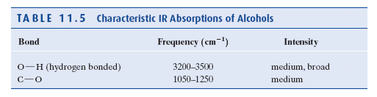
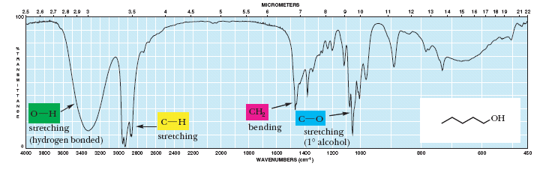
Alcohols
The position and intensity of an O-H absorption depends on the extent of hydrogen bonding

Slide 18
Summary of IR absorptions:
Alkanes: 2800 – 3000 cm⁻¹, 1400-1500 cm⁻¹
C=C: 3100 cm⁻¹, 1600 cm⁻¹
ROH: broad OH, 1050 – 1250 cm⁻¹
ROR: 1050 – 1250 cm⁻¹
Amines: 3100-3500 cm⁻¹ : 1º: 2 peaks, 2º: 1 peak, 3º: no peaks
C=O: 1705 – 1780 cm⁻¹
Benzene: 3030 cm⁻¹, 1700 – 2000 cm⁻¹ (benzene fingers), 1600 cm⁻¹, 1500 cm⁻¹, 700 – 750 cm⁻¹

Slide 19
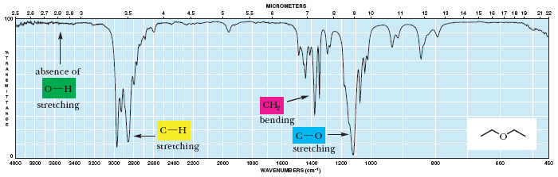
Ethers

Slide 20
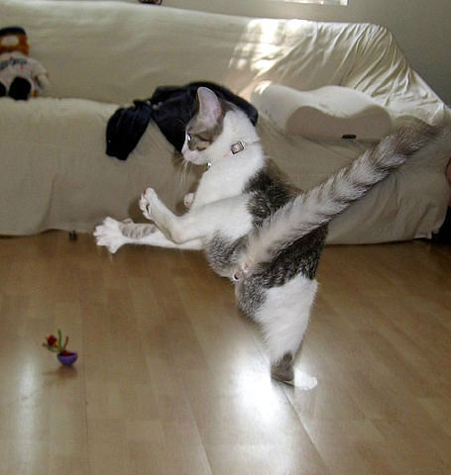

Slide 21
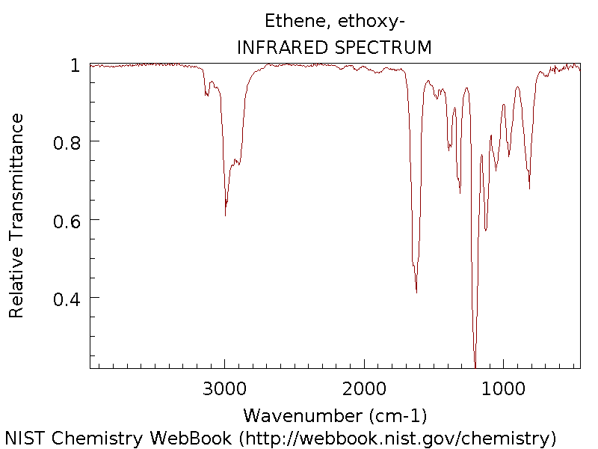
OF AN UNKNOWN
C-C
C-H
Alkanes: 2800 – 3000 cm⁻¹, 1400-1500 cm⁻¹
C=C: 3100 cm⁻¹, 1600 cm⁻¹
ROH: broad OH, 1050 – 2050 cm⁻¹
ROR: 1050 – 2050 cm⁻¹

Slide 22
Summary of IR absorptions:
Alkanes: 2800 – 3000 cm⁻¹, 1400-1500 cm⁻¹
C=C: 3100 cm⁻¹, 1600 cm⁻¹
ROH: broad OH, 1050 – 1250 cm⁻¹
ROR: 1050 – 1250 cm⁻¹
Amines: 3100-3500 cm⁻¹ : 1º: 2 peaks, 2º: 1 peak, 3º: no peaks
C=O: 1705 – 1780 cm⁻¹
Benzene: 3030 cm⁻¹, 1700 – 2000 cm⁻¹ (benzene fingers), 1600 cm⁻¹, 1500 cm⁻¹, 700 – 750 cm⁻¹

Slide 23
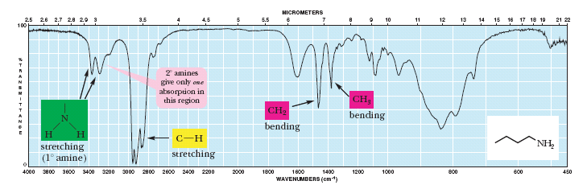
Amines
N-H stretching vibrations appear in the region 3100 to 3500 cm⁻¹.
  1° amines have two absorptions in this region.
  2° amines have one.
  3° amines have none.

Slide 25
Summary of IR absorptions:
Alkanes: 2800 – 3000 cm⁻¹, 1400-1500 cm⁻¹
C=C: 3100 cm⁻¹, 1600 cm⁻¹
ROH: broad OH, 1050 – 1250 cm⁻¹
ROR: 1050 – 1250 cm⁻¹
Amines: 3100-3500 cm⁻¹ : 1º: 2 peaks, 2º: 1 peak, 3º: no peaks
C=O: 1705 – 1780 cm⁻¹
Benzene: 3030 cm⁻¹, 1700 – 2000 cm⁻¹ (benzene fingers), 1600 cm⁻¹, 1500 cm⁻¹, 700 – 750 cm⁻¹

Slide 26
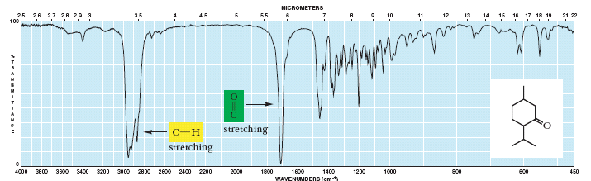
Aldehydes & Ketones
Aldehydes and ketones show strong C=O absorptions between 1705 and 1780 cm⁻¹.

Slide 28
Summary of IR absorptions:
Alkanes: 2800 – 3000 cm⁻¹, 1400-1500 cm⁻¹
C=C: 3100 cm⁻¹, 1600 cm⁻¹
ROH: broad OH, 1050 – 1250 cm⁻¹
ROR: 1050 – 1250 cm⁻¹
Amines: 3100-3500 cm⁻¹ : 1º: 2 peaks, 2º: 1 peak, 3º: no peaks
C=O: 1705 – 1780 cm⁻¹
Benzene: 3030 cm⁻¹, 1700 – 2000 cm⁻¹ (benzene fingers), 1600 cm⁻¹, 1500 cm⁻¹, 700 – 750 cm⁻¹

Slide 29
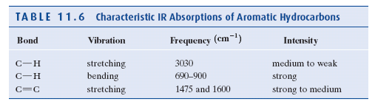
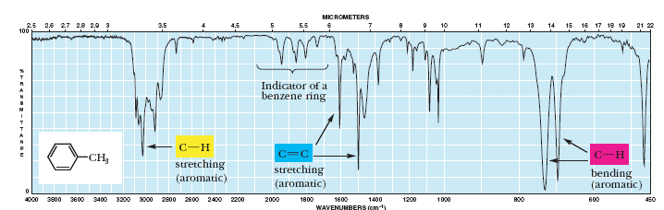
Benzene and its Derivatives

Slide 31
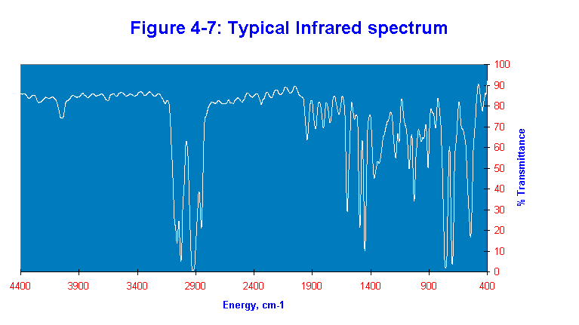
1700-2000
1900
1700
1600
1600
3030
1500
700-750
3100
800
2900
2900
1400
Alkanes: 2800 – 3000 cm⁻¹, 1400-1500 cm⁻¹
C=C: 3100 cm⁻¹, 1600 cm⁻¹
ROH: broad OH, 1050 – 2050 cm⁻¹
ROR: 1050 – 2050 cm⁻¹
Amines: 3100 – 3500 cm⁻¹ : 1º: 2 peaks, 2º: 1 peak, 3º: no peaks
C=O: 1705 – 1780 cm⁻¹
Benzene: 3030 cm⁻¹, 1700 – 2000 cm⁻¹ (benzene fingers), 1600 cm⁻¹, 1500 cm⁻¹, 700 – 750 cm⁻¹

Slide 32
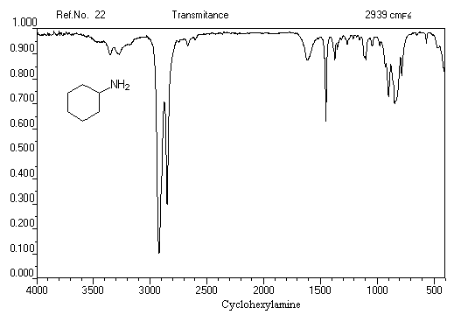
Alkanes: 2800 – 3000 cm⁻¹, 1400-1500 cm⁻¹
C=C: 3100 cm⁻¹, 1600 cm⁻¹
ROH: broad OH, 1050 – 2050 cm⁻¹
ROR: 1050 – 2050 cm⁻¹
Amines: 3100 – 3500 cm⁻¹ : 1º: 2 peaks, 2º: 1 peak, 3º: no peaks
C=O: 1705 – 1780 cm⁻¹
Benzene: 3030 cm⁻¹, 1700 – 2000 cm⁻¹ (benzene fingers), 1600 cm⁻¹, 1500 cm⁻¹, 700 – 750 cm⁻¹

Slide 33
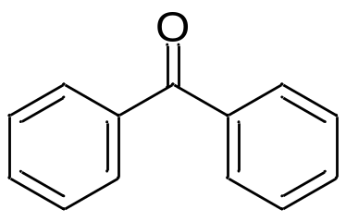

Slide 36
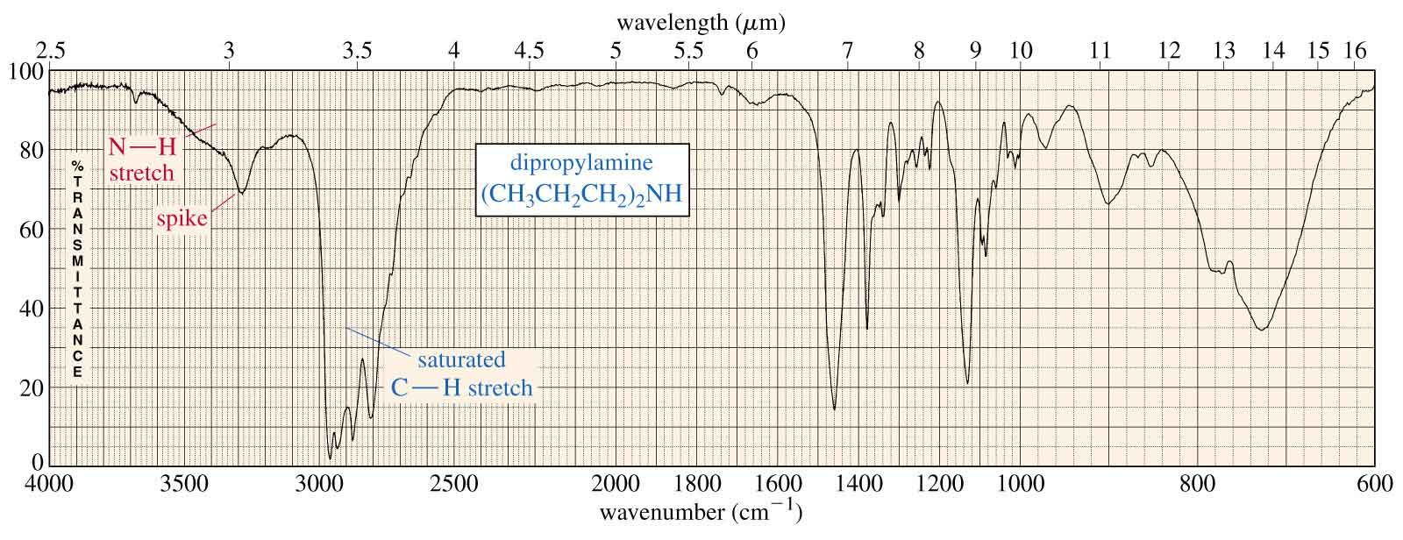
An Amine IR Spectrum

